Slide 1
NETWORK LAYER
(Functions of Layer, IPV4 – Addressing, IP Packet Headers,
IP Address Assignment-Functions of IANA, AFRINIC, KENIC and ISPs)
ECE 422-Data Communication & Computer Networks
Monday, 09 March 2026

Slide 2
WHERE ARE WE IN THE SYLLABUS…
Course Content:
Introduction: Overview of Data Communications and Networking.
Physical Layer: Analog and Digital, Analog Signals, Digital Signals, Analog versus Digital, Data Rate Limits, Transmission Impairment, More about signals.
Digital Transmission: Line coding, Block coding, Sampling, Transmission mode.
Analog Transmission: Modulation of Digital Data; Telephone modems, modulation of Analog signals.
Multiplexing: FDM, WDM, TDM.
Transmission Media: Guided Media, Unguided media (wireless).
Data Link Layer: Error Detection and correction - Types of Errors, Detection, Error Correction; Data Link Control and Protocols-Flow and Error Control, Stop-and-wait ARQ. Go-Back-N ARQ, Selective Repeat ARQ, HDLC. Point-to-Point Access- Point–to-Point Protocol (PPP), PPP Stack, Multiple Access Random Access, Controlled Access, Channelization.
Network Layer: Host to Host Delivery: Internetworking, addressing and Routing Network Layer Protocols: ARP, IPV4, ICMP, IPV6 and ICMPV6
Transport Layer: Process to Process Delivery: UDP; TCP congestion control and Quality of service.
Application Layer: Client Server Model, Socket Interface, Domain Name System (DNS): Electronic Mail (SMTP) and file transfer (FTP) HTTP and WWW.
Local area Network: Ethernet - Traditional Ethernet, Fast Ethernet, Gigabit Ethernet; Token bus, token ring; Wireless LANs - IEEE 802.11, Bluetooth virtual circuits: Frame Relay and ATM.
Industrial Communication and Control Networks: Transmission methods, Network topology, Contemporary networks – Profibus, Controller Area Network (CAN), DeviceNet, CANopen, Actuator Sensor Interface (AS-1),Industrial Ethernet.

Slide 3
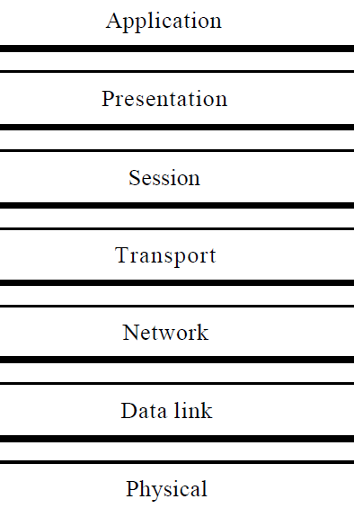
FUNCTION OF THE NETWORK LAYER
The Network Layer
Responsible for the source-to-destination delivery of a packet, possibly across multiple networks (links).
Functions include:
  Logical addressing
  Routing of Packets

Slide 4
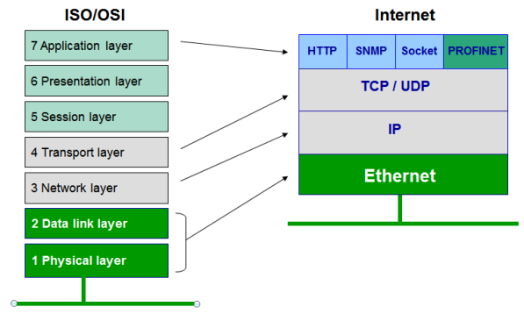
NETWORK LAYER IN TCP/IP
Internet Protocol version 4 (IPv4) is the fourth version of the Internet Protocol (IP).
It is one of the core protocols of standards-based internetworking methods in the Internet, and was the first version deployed for production in the ARPANET in 1983.
It still routes most Internet traffic today, despite the ongoing deployment of a successor protocol, IPv6.
IPv4 is described in IETF publication RFC 791 (September 1981).
What is RFC?
Request for Comments (RFC) is a type of text document from the technology community. An RFC document typically comes from the Internet Engineering Task Force (IETF), the Internet Research Task Force (IRTF) & the Internet Architecture Board (IAB),

Slide 5
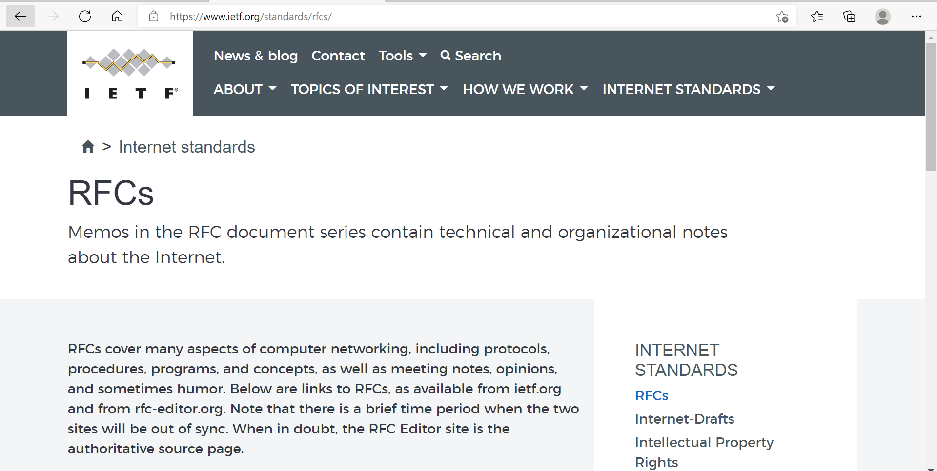
RFCs ARE AVAILABLE AT WEBSITE: IETF.ORG

Slide 6
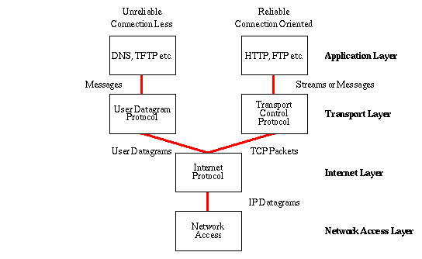
WHAT IS INTERNET PROTOCOL (IP)?
The internet protocol provides the functions necessary to deliver a package of bits (an internet datagram) from a source to a destination over an interconnected system of networks.
The internet modules use the addresses carried in the Internet Protocol header to transmit internet datagrams toward their destinations. The selection of a path for transmission is called routing.
The internet modules use fields in the internet header to fragment and reassemble internet datagrams when necessary for transmission through "small packet" networks.

Slide 7
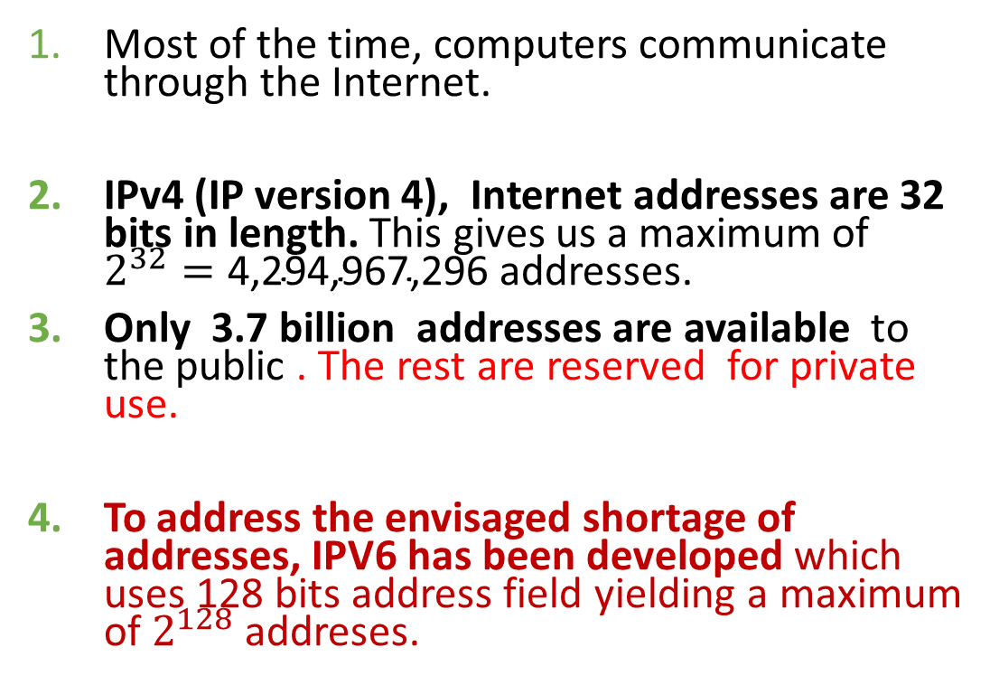
IP PROTOCOL
Most of the time, computers communicate through the Internet.
IPv4 (IP version 4), Internet addresses are 32 bits in length. This gives us a maximum of $2^{32}=\text{4,294,967,296}$ addresses.
Only 3.7 billion addresses are available to the public . The rest are reserved for private use.
To address the envisaged shortage of addresses, IPV6 has been developed which uses 128 bits address field yielding a maximum of $2^{128}$ addreses.

Slide 8
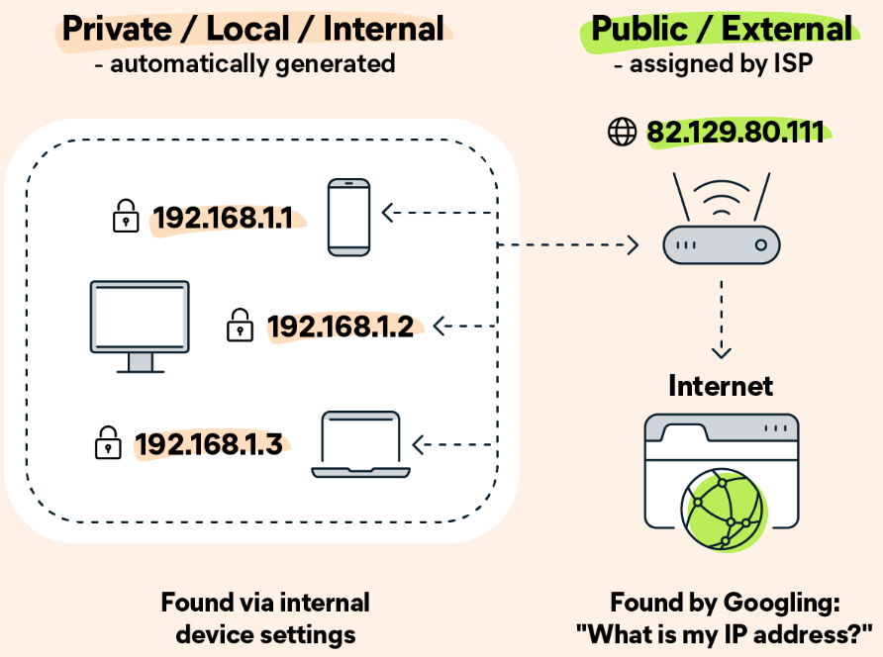
PRIVATE & PUBLIC IP ADDRESSES
A public IP address identifies you to the wider internet so that all the information you’re searching for can find you.
A private IP address is used within a private network to connect securely to other devices within that same network.

Slide 9
IPV4 ADDRESS FIELD
IPv4 addresses are unique in the sense that each address defines one, and only one, connection to the Internet.
Two devices cannot have the same IPV4 address at the same time.
However, it is possible to have an address shared by two devices at different times through what is referred to as Dynamic Host Configuration Protocol(DHCP).
If a device operating at the network layer has m connections to the Internet, it needs to have m addresses.

Slide 10
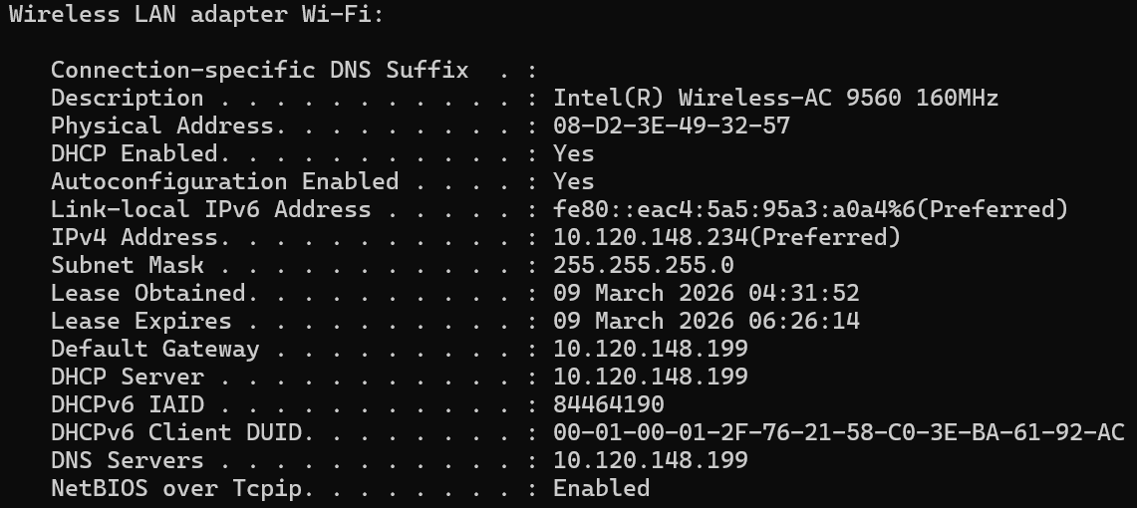
HOW DO I FIND YOUR IP ADDRESS?
Click on your Start Menu and type cmd in the search box and press enter. A black and white window will open
To find your IP enter ipconfig /all and press enter.

Slide 11
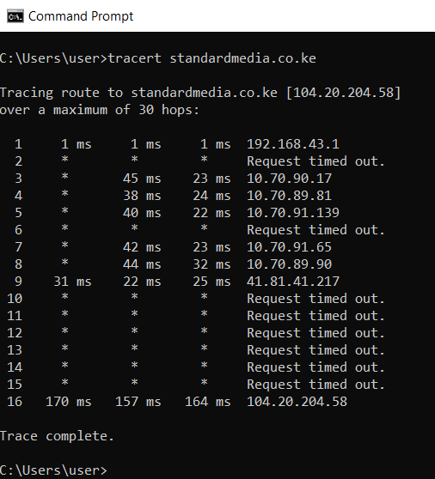
HOW DO I FIND THE IP ADDRESS OF A DOAIN NAME?
Click on your Start Menu and type cmd in the search box and press enter. A black and white window will open
To find the IP address of a website use Tracert command (Trace route Command) . At the prompt, type in tracert and leave a single space, then type in your website's address
10.70.x.x Addresses
Net Range: 10.0.0.0 - 10.255.255.255
CIDR: 10.0.0.0/8
NetName: PRIVATE-ADDRESS--RFC1918-IANA-RESERVED
Comment: These addresses are in use by many millions of independently operated networks, which might be as small as a single computer connected to a home gateway, and are automatically configured in hundreds of millions of devices. They are only intended for use within a private context.

Slide 12
INTERPRETING TRACERT RESULTS
Tracing route to nation.africa [104.18.28.152]
NO OF HOPS | RTT1 | RTT2 | RTT3 | IP ADDRESS
12 | 81 | 74 | 74 | 192.168.100.1
RTT
Trip time (RTT) for your packet to reach that point and return to your computer
IP ADDRESS
IP address of the router.
NO OF HOPS
Number of the hop along the route

Slide 13
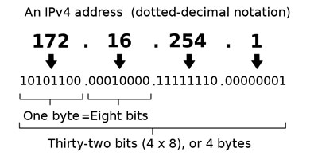
IPV4 NOTATIONS
There are two IPV4 notations, i.e
  Dotted Decimal Notation which written in decimal form with a decimal point (dot) separating the bytes.
  Binary Notation where address is displayed in a 32-bit binary form.

Slide 14
WORKED EXAMPLE
Find the error, if any, in the following IPv4 addresses.
111.56.045.78
221.34.7.8.20
75.45.301.14
11100010.23.14.67
X - There must be no leading zero (Error - 045).
X - There can be no more than four numbers in an IPv4 address.
X - Each number needs to be less than or equal to 255 (301 is outside this range).
X - A mixture of binary notation and dotted-decimal notation is not allowed.

Slide 15
CLASSFUL ADDRESSING
In the beginning, IPv4 addressing used the concept of classes.
The address space was divided into five classes: A, B, C, D, and E. Each class occupied some part of the IPV4 address space.
The first few bits in the first byte can immediately tell us the class of the address.
 | LEADING BITS (DECIMAL RANGE) | 2ND BYTE | 3RD BYTE | 4TH BYTE
CLASS A | 0 (0 – 127)
CLASS B | 10 (128 – 191)
CLASS C | 110 (192 – 223)
CLASS D | 1110 (224 – 239)
CLASS E | 1111 (240 – 255)

Slide 16
CLASSFUL ADDRESSING (2)
 | LEADING BITS (DECIMAL-RANGE) | NO. OF NETWORKS | ADDRESSES PER NETWORK | START ADDRESS | END ADDRESS
CLASS A | 0 (0 – 127) | 128 (2⁷) | 16,777,216(2²⁴) | 0.0.0.0 | 127.255.255.255
CLASS B | 10 (128 – 191) | 16,384(2¹⁴) | 65,536(2¹⁶) | 128.0.0.0 | 191.255.255.255
CLASS C | 110 (192 – 223) | 2,097,152 (2²¹) | 256(2⁸) | 192.0.0.0 | 223.255.255.255
CLASS D | 1110 (224 – 239) | Not defined | Not defined | 224.0.0.0 | 239.255.255.255
CLASS E | 1111 (240 – 255) | Not defined | Not Defined | 240.0.0.0 | 255.255.255.255

Slide 17
WORKED EXAMPLE
Find the class of each addresses below:
00000001 00001011 00001011 11101111
11000001 10000011 00011011 11111111
14.23.120.8
252.5.15.111
The first bit is O. This is a class A address.
The first 2 bits are 1; the third bit is O. This is a class C address.
The first byte is 14 (between 0 and 127); the class is A.
The first byte is 252 (between 240 and 255); the class is E.

Slide 18
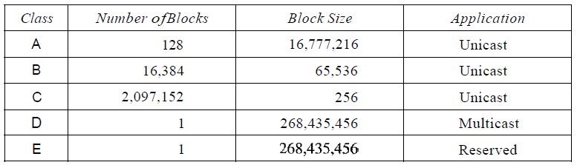
BLOCKS & BLOCK SIZES IN IPV4
A unicast address identifies a unique node on a network. Typically refers to a single sender or a single receiver
Reserved for large organizations with a large number of attached hosts or routers. Too Large!
Reserved for midsize organizations with tens of thousands of attached hosts or routers. Too Large!
Reserved for small organizations with a small number of
attached hosts or routers. Too Small.
Reserved for future use Wasted!
In c1assful addressing, a large part of the available addresses were wasted.

Slide 19
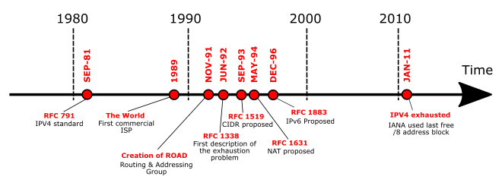
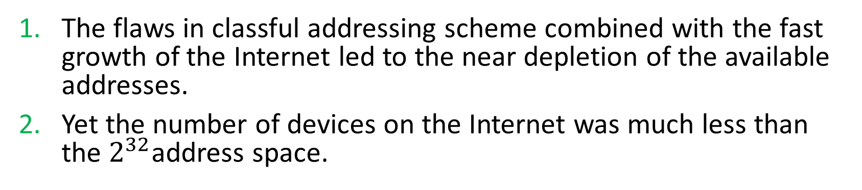
DEPLETION OF IP ADDRESSES
The flaws in classful addressing scheme combined with the fast growth of the Internet led to the near depletion of the available addresses.
Yet the number of devices on the Internet was much less than the $2^{32}$address space.

Slide 20
CLASSLESS ADDRESSING
In classless addressing, when an entity needs to be connected to the Internet, it is granted a block (range) of addresses.
The size of the block (the number of addresses) varies based on the nature and size of the entity.

Slide 21
RESTRICTIONS ON CLASSLESS ADDRESSING
To simplify the handling of addresses, the Internet authorities impose three restrictions on classless address blocks:
The addresses in a block must be contiguous, i.e one after another.
The number of addresses in a block must be a power of 2 , i.e 2^{I}, 2², 2⁴, 2⁸, ... ).
The first address must be evenly divisible by the number of addresses.

Slide 22
IPv4 ROUTING MECHANISMS
The original Internet protocol used four key mechanisms in providing services, i.e
Type of Service indicate the quality of the service desired.
Time to Live an upper bound on the lifetime of an internet datagram.
Options provides control functions r timestamps, security, and special routing.
Header Checksum provides a verification that the information used in processing internet datagram has been transmitted correctly.
Errors detected may be reported via the Internet Control Message Protocol (ICMP)

Slide 23
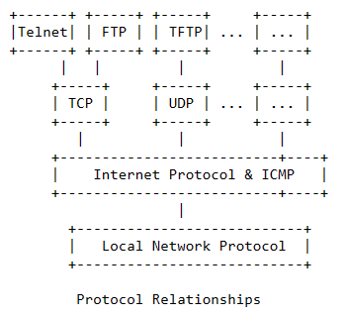
INTERNET CONTROL MESSAGE PROTOCOL (ICMP)
Internet Control Message Protocol (ICMP) is a network layer protocol used by network devices to diagnose network communication issues.
Functions of the ICMP include:
  Error reporting: why a datagram that was not discarded due to errors was not delivered to the destination
  Reachability testing: an echo message is sent to which the host must respond if it is up, e.g ping
  Congestion control: Source quench message is sent when datagrams are dropped because of buffer overflow.
  Route-change information: when a router realizes that a host should be using a different router to reach a destination it sends a message with the updated routing information.
  Performance measuring: check the time it takes to send datagrams to particular locations.

Slide 24
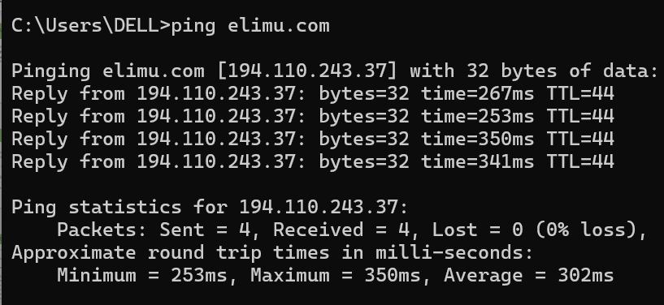
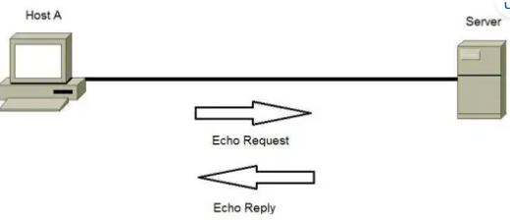
APPLICATION OF ICMP: REACHABILITY & PERFORMANCE

Slide 25
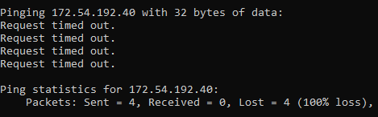
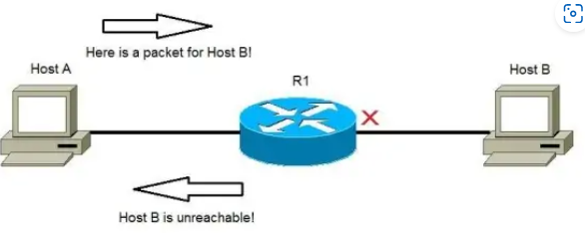
APPLICATION OF ICMP: REACHABILITY & PERFORMANCE

Slide 26
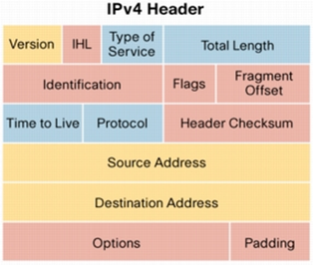
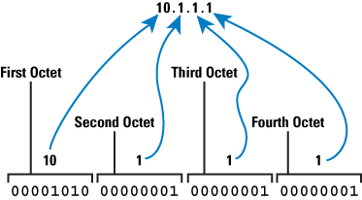
IPv4 PACKET HEADER
The IPv4 packet header consists of 14 fields, of which 13 are required. The 13th field is optional and aptly named: options.
IPv4
10.1.1.1
10.1.0.2

Slide 27
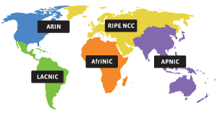
INTERNET ASSIGNED NUMBERS AUTHORITY(IANA)
Internet Assigned Numbers Authority (IANA) based in the United States, assigns and allocates IP addresses in a systematic, organized and consistent manner that benefits everyone globally.
With more than four billion IP addresses assigned worldwide, it's a bit overwhelming for just one single organization to handle.
Part of the IP address allocation process has been simplified by assigning large blocks of IP addresses to Regional Internet Registries (RIR).
Réseaux IP Européens Network Coordination Centre
African Network Information Centre
Latin America and Caribbean Network Information Centre

Slide 28
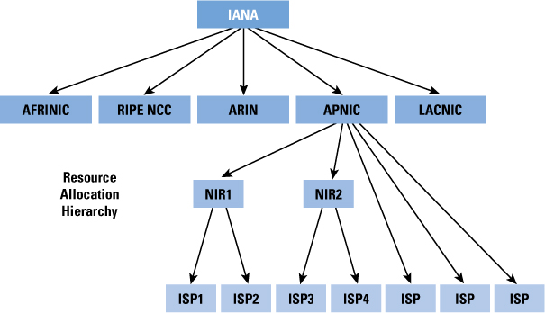
ORGANIZATIONS INVOLVED IN NUMBER ASSIGNMENT
Internet Assigned Numbers Authority
American Registry for Internet Numbers
KENIC
Kenya Network Information Centre

Slide 29
REGIONAL INTERNET REGISTRY (RIR)
Regional Internet Registry (RIR) is an organization that manages and controls Internet addresses in a specific region, usually a country and sometimes an entire continent. RIRs control assigning and distributing IP addresses and domain registrations.
American Registry for Internet Numbers(ARIN): North America, including Canada, the United States and portions of the Caribbean.
Reseaux IP Europens Network Coordination Centre (RIPE NCC): Europe, the Middle East and Central Asia.
Asia-Pacific Network Information Centre (APNIC): Asia and the Pacific Rim.
Latin American and Caribbean Internet Address Registry (LACNIC): Latin America and the Caribbean.
African Network Information Centre (AfriNIC): African continent.

Slide 30
ROLE OF THE REGIONAL INTERNET REGISTRY (RIR)
The Internet Assigned Numbers Authority (IANA) allocates IP addresses to each RIR, which takes it from there, handling the next level of allocation. An RIR serves:
Large regional entities, including Internet Service Providers (ISPs)
Educational institutions
Governments
Large corporation and organizations

Slide 31
NUMBER RESOURCE ORGANIZATION
All five RIRs combined to form the Number Resource Organization (NRO).
The NRO helps the RIRs coordinate technical and policy initiatives among themselves.
The mission of the NRO is to:
  Keep tabs on the IP address resource pool, protecting available IP addresses
  Protect and promote the policies of the Internet
  Serve as a focal point for input from the Internet communities in each RIR.

Slide 32


Slide 33
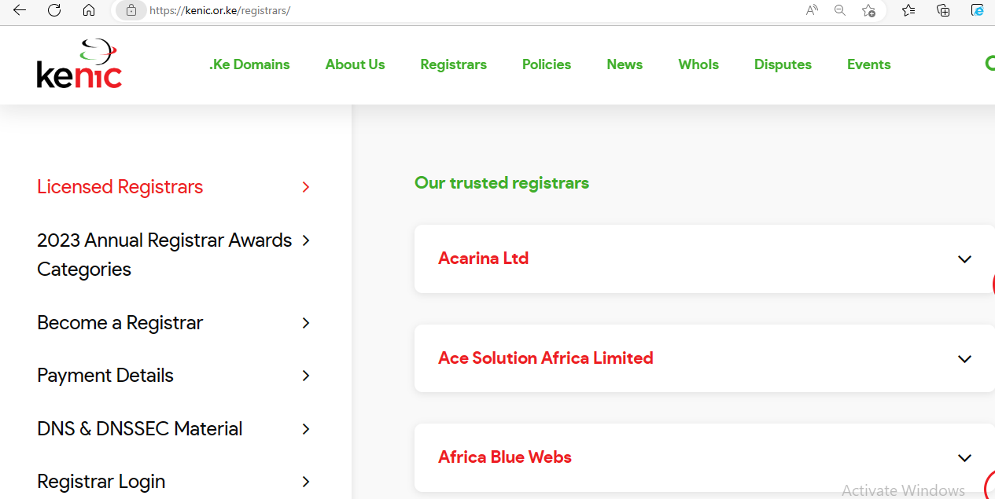

Slide 34
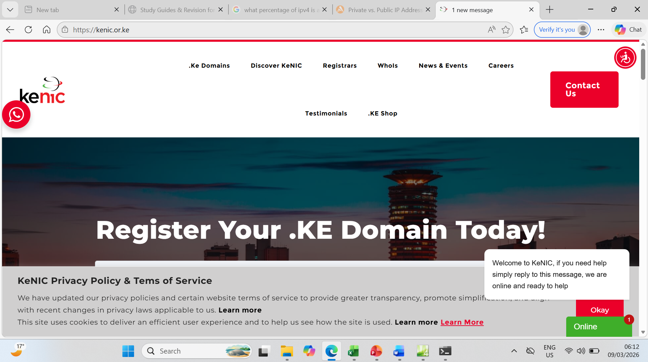

Slide 35
